Slide 1
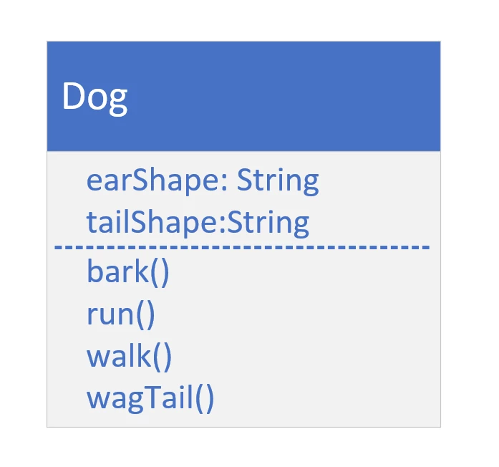

Class Diagram for Dog and Animal
COMPLETE JAVA MASTERCLASS
Inheritance - Part 3

Slide 2
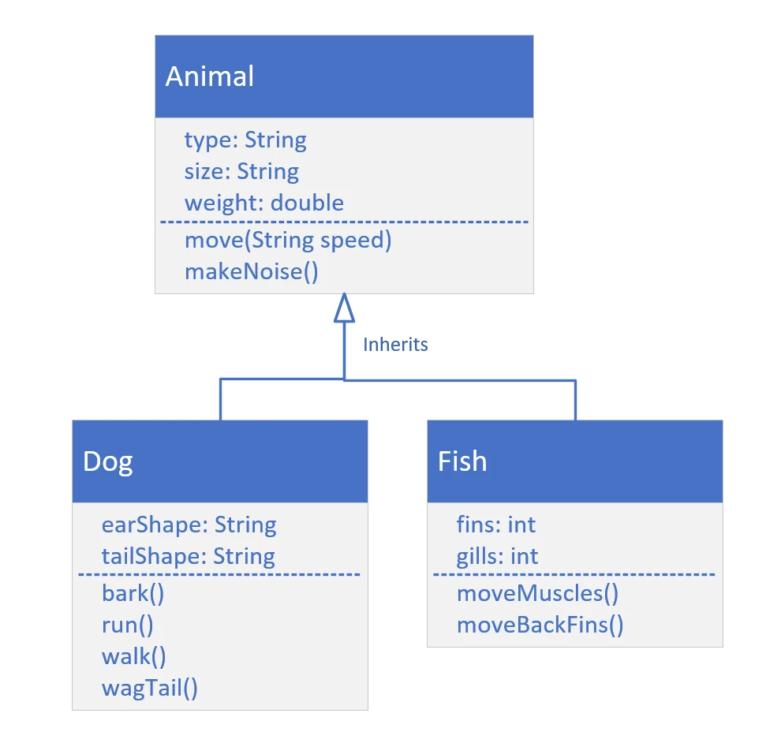
Class Diagram with additional class, Fish
COMPLETE JAVA MASTERCLASS
Inheritance - Part 3

Slide 3
Polymorphism
Polymorphism simply means 'many forms’.
And as you've seen, some advantages of Polymorphism are:
It makes code simpler.
It encourages code extensibility.
COMPLETE JAVA MASTERCLASS
Inheritance - Part 3

